Slide 1
Mobile Price Classification
Rabbi Islam Yeasin
Engineer of Computer Science
IBM Certified Professional Data Scientist
Machine Learning Intern,MentorNess

Slide 2
Outline
Problem Statement
Discovering Data
Work Steam
Tech Stack
Correlation Matrix
Pair Plot
Machine Learning Model
Suggestion

Slide 3
Problem Statement
The task is to build a predictive model that can accurately classify mobile phones into predefined price ranges based on various attributes such as battery power, camera features, memory, connectivity options and more. The dataset provided contains information about several mobile phones, including their specifications and corresponding price ranges.

Slide 4
Discovering Data
In this project, we obtain to explore and analyze a dataset that hold specifications of 2000 mobile phones as well as attempt to predict best price ranges for a list of mobile phones in the market by applying various machine learning algorithm.

Slide 5




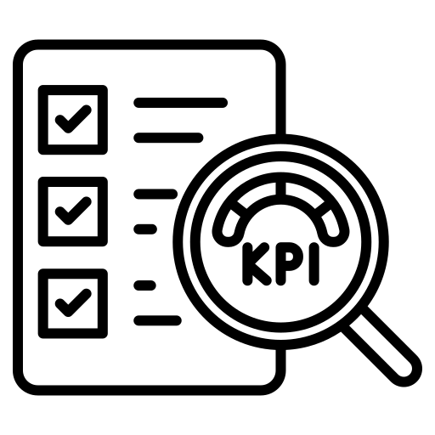
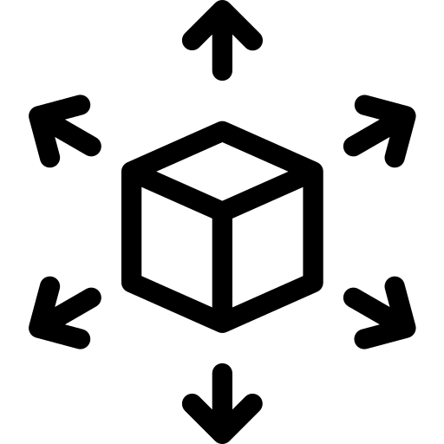
Work Steam
Data Collection
Define Models
Valid the best model
Compare Models
Deploy Model
EDA

Slide 6






Tech Stack
Python
Numpy
Seaborn
Mathplotlib
Scikitlearn
Pandas

Slide 7
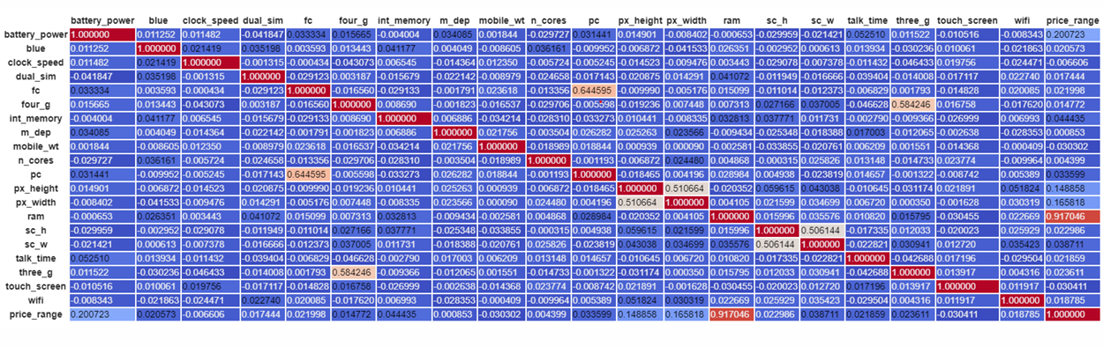
Correlation Matrix
Insights –
Battery power does not appear to be strongly correlated with any of the other features.
Clock speed has a weak positive correlation with several features, including dual sim support, internal memory, and number of cores
Internal memory has a weak positive correlation with several features, including pixel height and pixel width
Pixel height and pixel width are strongly correlated with each other (correlation coefficient of 0.584). This is unsurprising, as these two features are both measures of the screen resolution of a mobile phone.

Slide 8
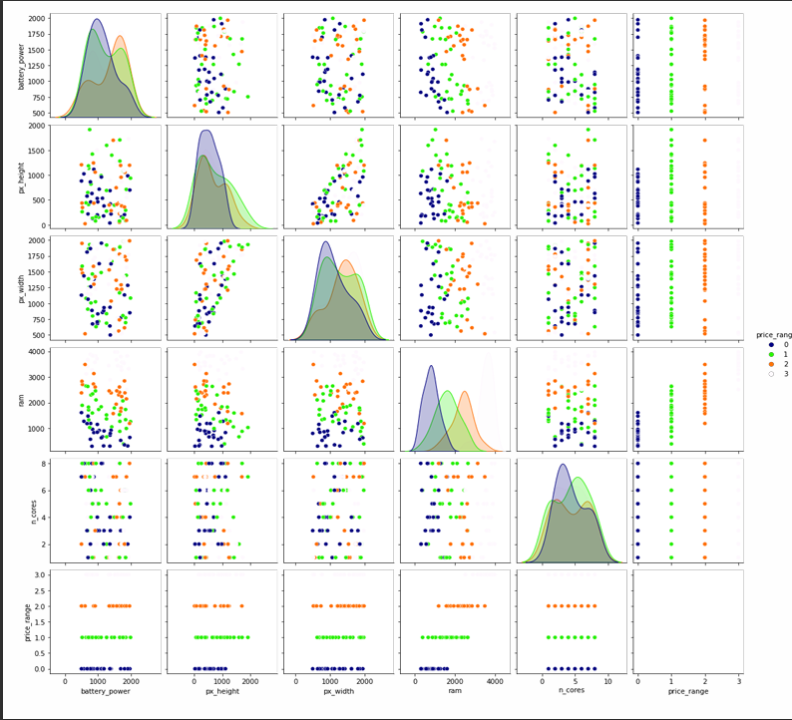
Pair Plot
Insights-
Battery Power: There isn't a strong correlation between battery power and any other features listed.
Clock Speed: There's a weak positive correlation between clock speed and several features, including dual sim support, internal memory, and number of cores. This might suggest that phones with faster processors tend to have these other features as well.
Internal Memory: Internal memory has a weak positive correlation with several features, including pixel height and pixel width. This is perhaps unsurprising, as phones with larger screens tend to have more storage space.
Pixel Height and Width: Pixel height and pixel width are strongly correlated with each other. This makes sense, since they both measure the screen resolution of a mobile phone.

Slide 9


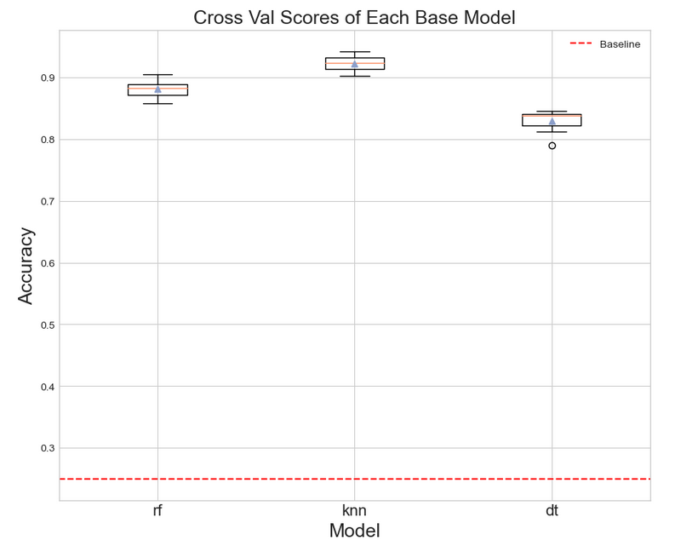
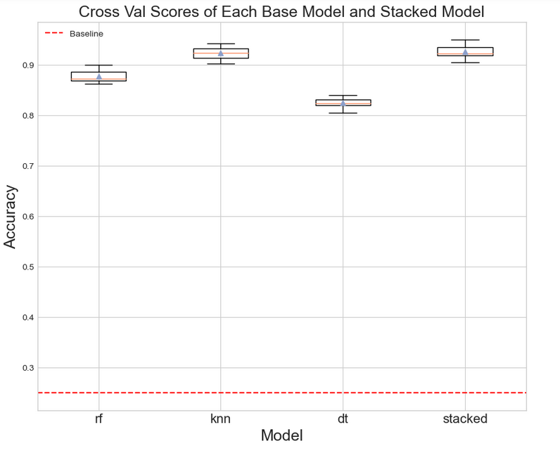

Machine Learning Model
Insights -
the stacked ensemble model achieved the best performance among the four models tested. K-Nearest Neighbors comes in a close second, while Random Forest shows good performance. The Decision Tree model performed the least well in this comparison

Slide 10
Suggestion
Focus on Stacked Ensemble or KNN:
Investigate Feature Engineering:
Consider Hyperparameter Tuning:
The correlation matrix shows some weak to moderate correlations between features like clock speed, internal memory, and pixel dimensions. This suggests there might be opportunities to create new features by combining existing ones or through feature engineering techniques. These new features could potentially improve the performance of all the models, especially the decision tree which had the lowest score (0.8245).
While the current models seem to be performing well, there might still be room for improvement through hyperparameter tuning. Hyperparameters are settings that control the learning process of a model. Tuning these parameters can significantly impact the model's performance. You could explore techniques like grid search or randomized search to find the optimal hyperparameter settings for each model
Since the stacked ensemble model achieved the best score (0.9255) and KNN follows closely behind (0.9228), these models are the most promising options for prediction on this dataset. You can deploy the stacked ensemble model for the best overall performance, or KNN if there are computational constraints and interpretability is a priority (KNN is generally easier to understand than stacked ensembles)

Slide 11





Thank You
Rabbi Islam Yeasin
Engineer of Computer Science
IBM Certified Professional Data Scientist
Machine Learning Intern, MentorNess

